Slide 1


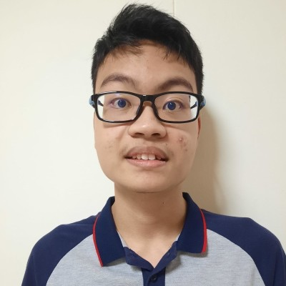
TOMOWORK GOAL SETTING WORKSHEET
NAME
Tay Yee Jie, Tayson
INSTITUTE
Republic Polytechnic
GOAL START DATE
20 MARCH 2023
GOAL COMPLETION DATE
1 JUNE 2023
MY CAREER GOAL IN 3 YEARS
WORK
Continue my passion for the sciences, especially in the biotech industry. Consider being a DNA analyst or manufacturer during my internship period.
LEARNING
If I go to university, I would be in Year 3 of University learning all about pharmaceutical manufacturing. Besides that, I would be undertaking online courses in Coursera and Workfare.
ACTIVITIES
I might explore volunteering in Youth Corps to give back my time to the community. Other than Youth Corps, I might considering doing sports to keep myself active.
5 THINGS I WANT TO ACHIEVE FROM TAP (Please include more than 1 soft skills)
ACTION THAT WILL HELP ME TO REACH MY GOAL
REVIEW
(REVIEW BY 31 MAY MORNING)
1 | Digital marketing skills
2 | Greater sense of mental wellbeing
3 | Project management
4 | Greater interpersonal skills
5 | Public speaking
1 | Take part in the digital marketing course
2 | Engage in less drama and practice mindfulness
3 | Learn as much as possible during corporate projects and learn from the professionals
4 | Strive to resolve more conflicts and read nonverbal cues
5 | Practice when my team goes for lunch breaks
1
2
3
4
5
COMMENTS FROM FACILITATORS

